Slide 1
Effective Population Size
Heath Blackmon
Guest Lecture - Population Genetics

Slide 2
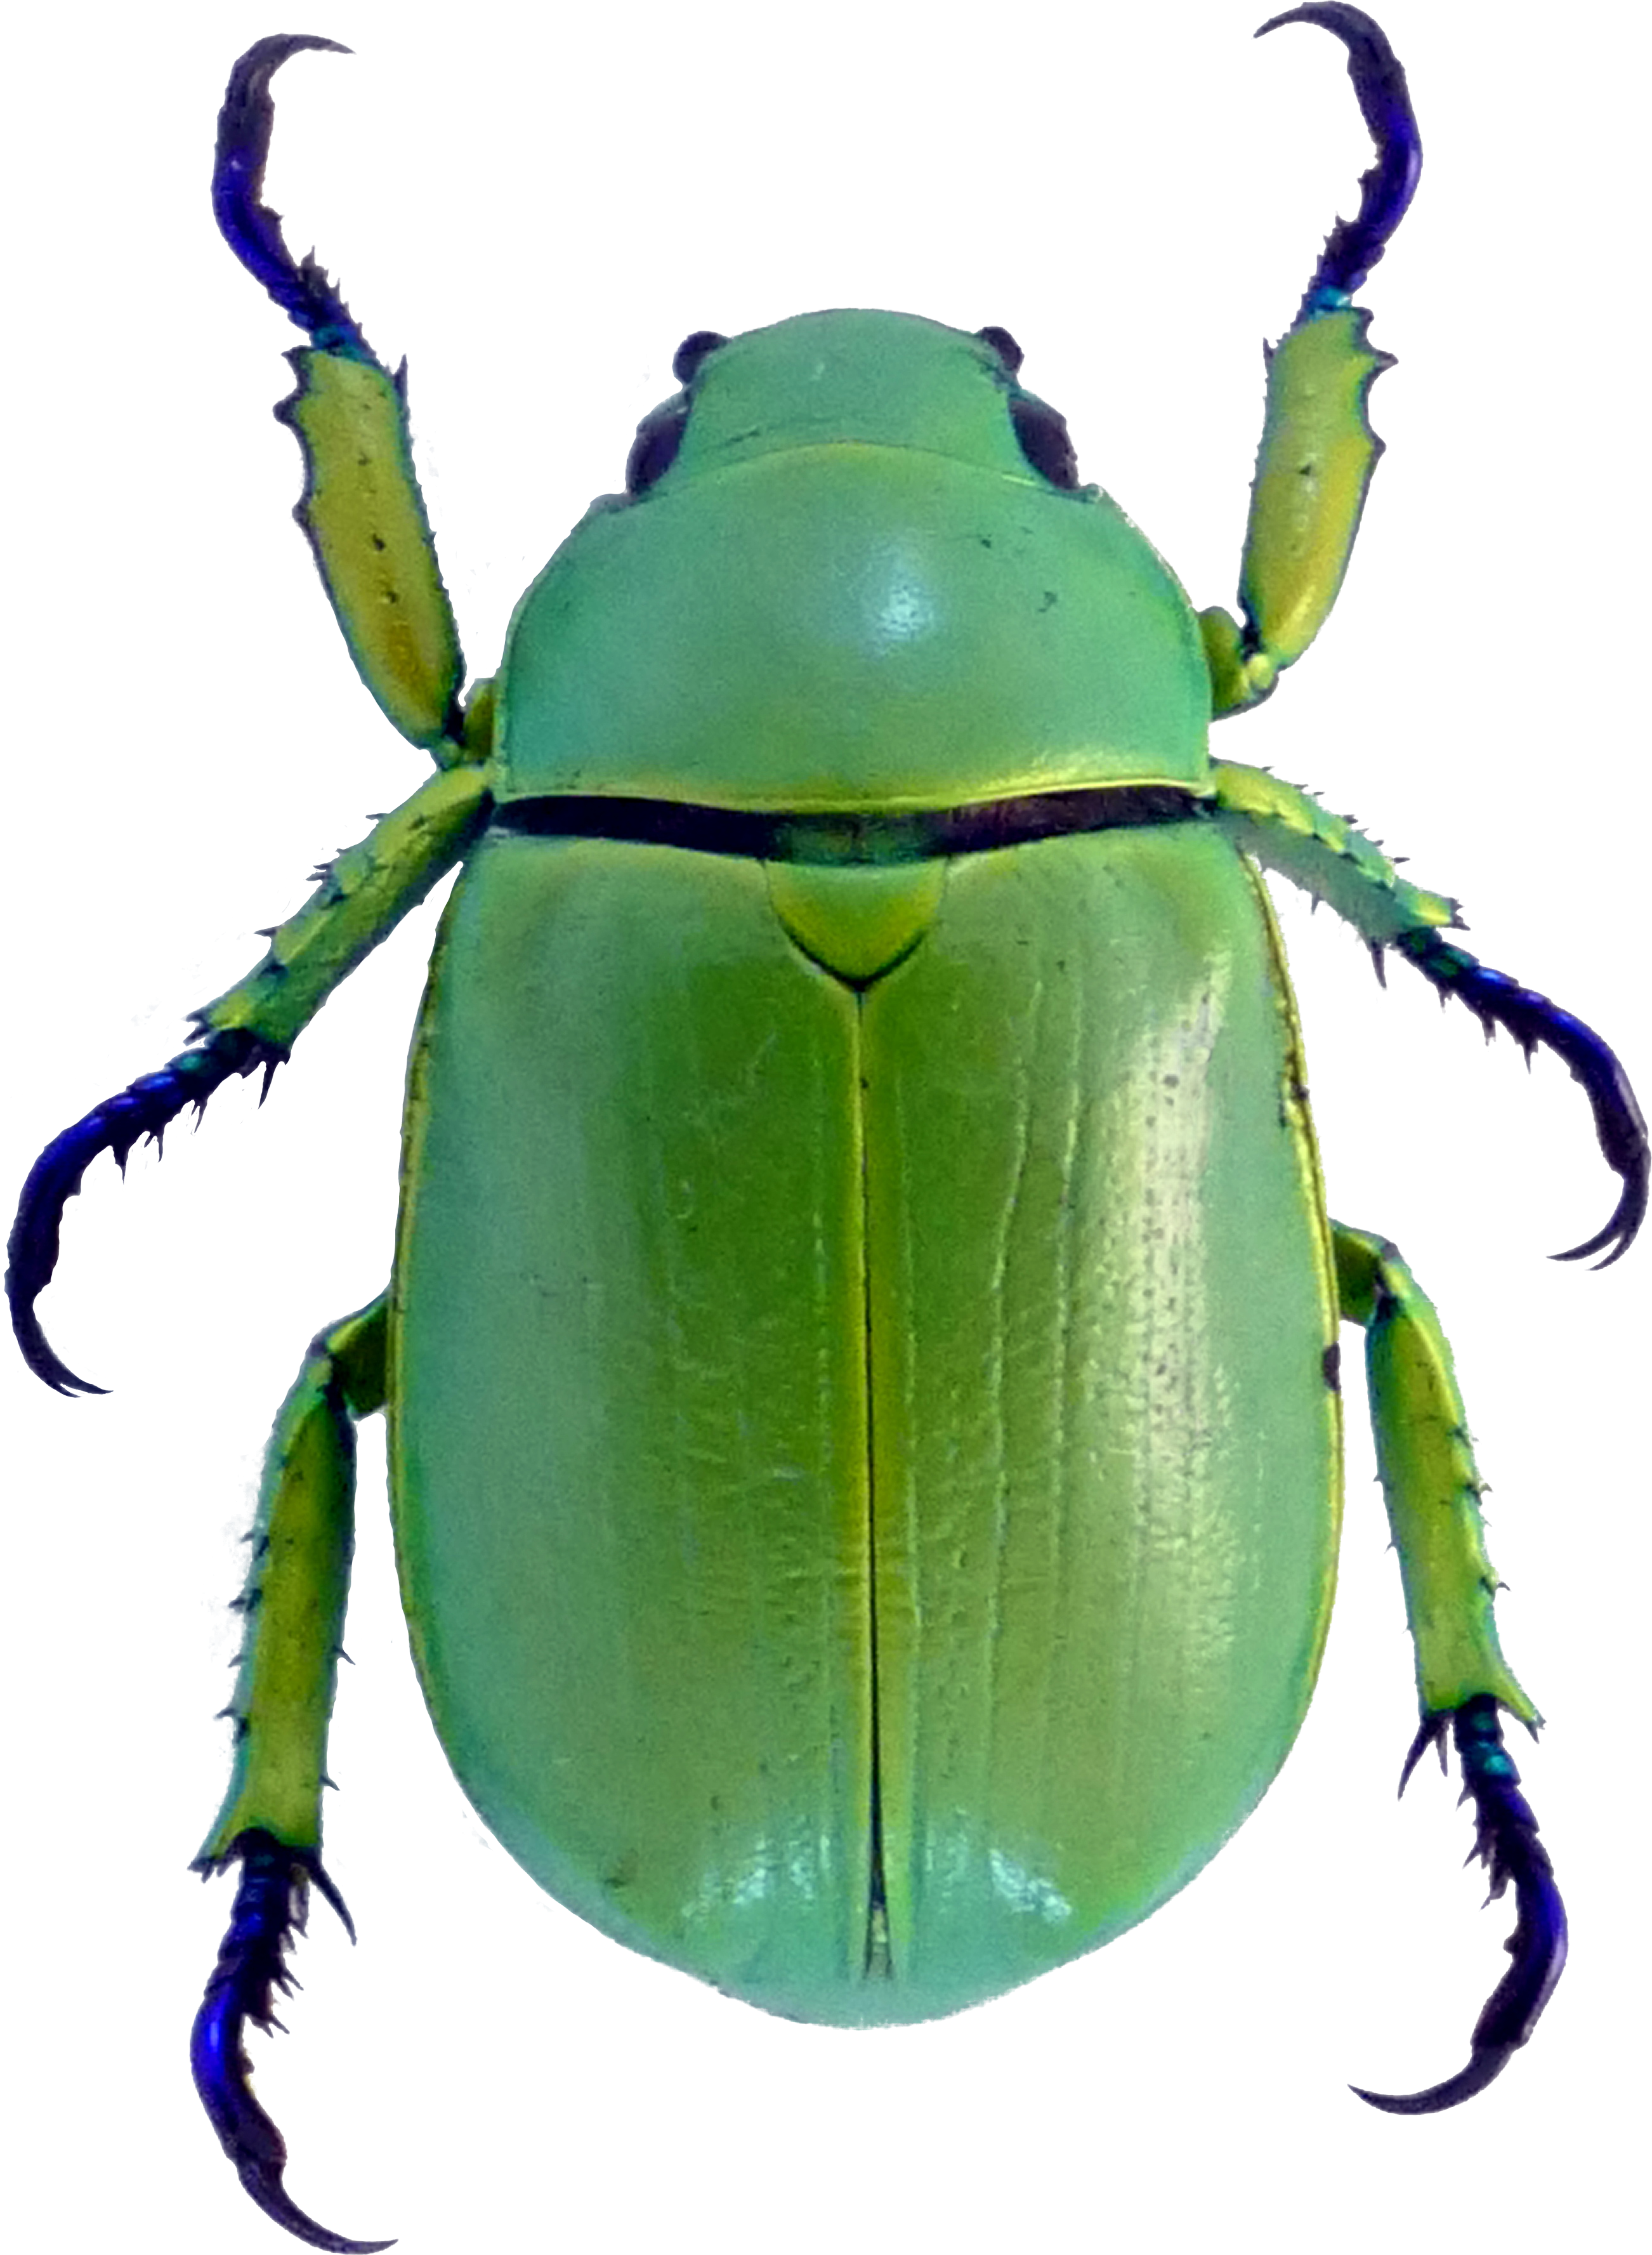
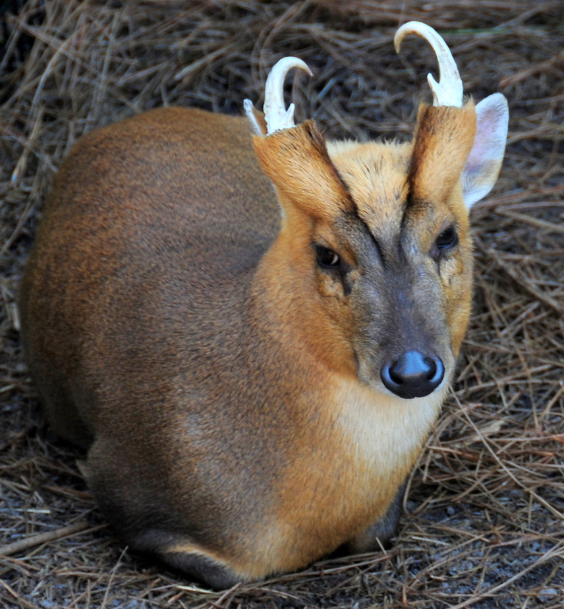
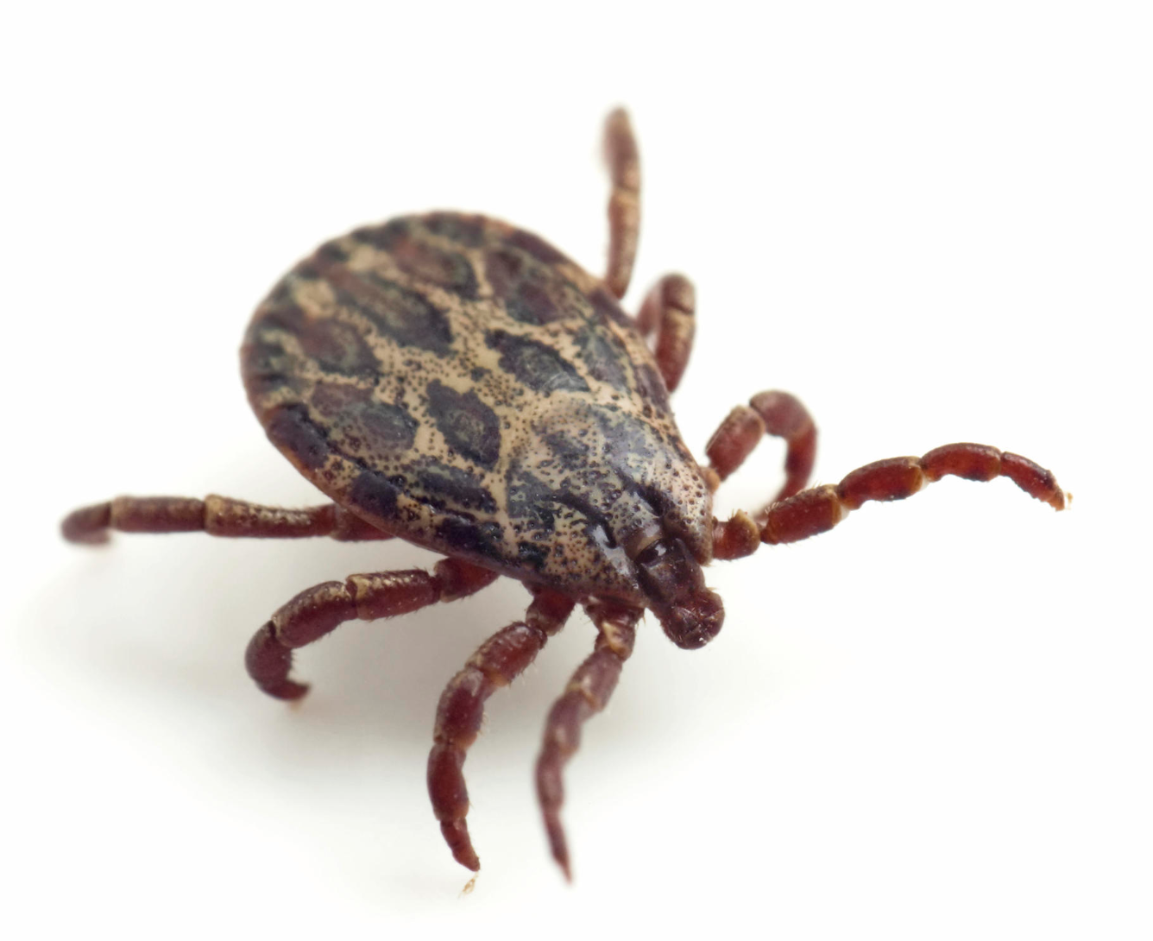
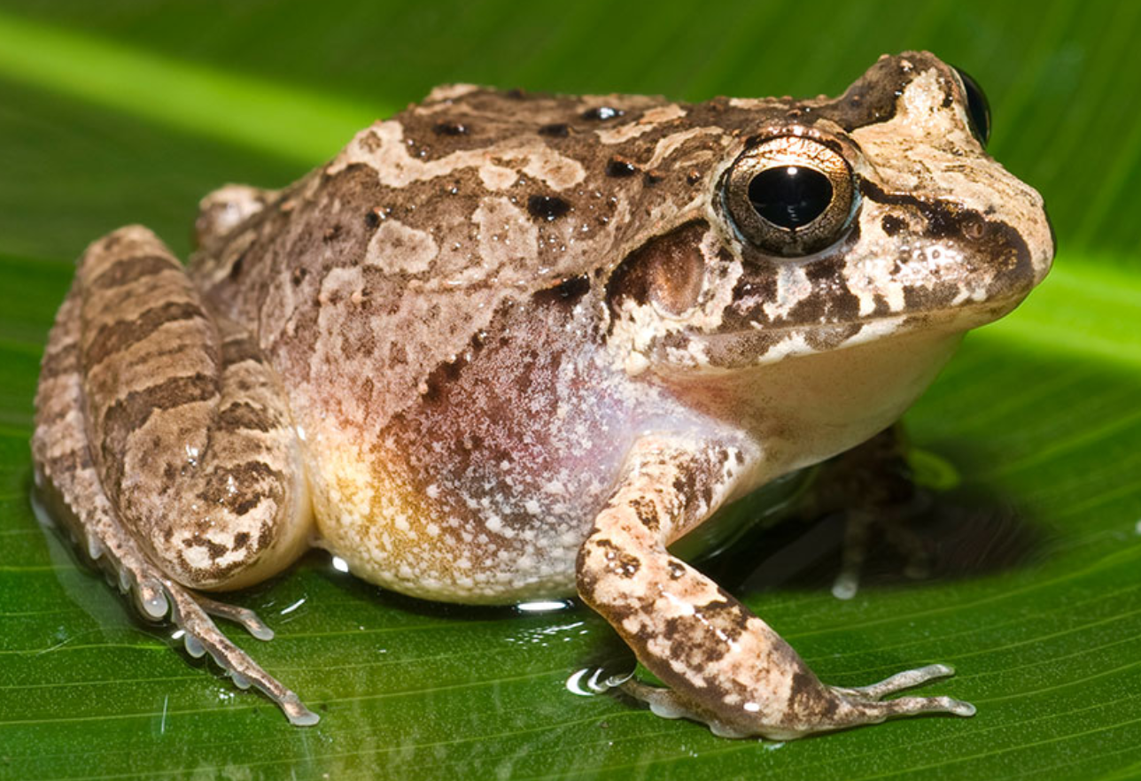
Evolutionary Biology
Genomics
Analyzing whole genome data to understand what and how genes impact traits
Trait
Evolution
Genetics
Studying the way traits are inherited
Theory
Applying math to ask how traits can evolve

Slide 3
Why does effective population size matter to me?
The balance between drift and selection determine the fate of beneficial and deleterious mutations

Slide 4
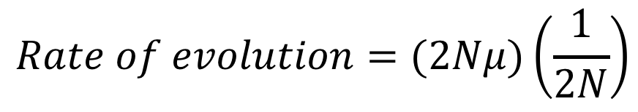
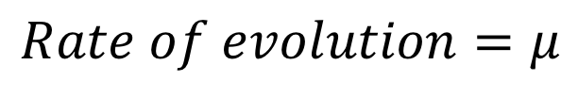
What is the fitness of a mutation that changes chromosome number?
Mutations are roughly neutral
-1 0 1
fitness
$$Rate of evolution=(2Nμ)\left(\frac{1}{2N}\right)$$
$$Rate of evolution=μ$$
Rate of evolution
Small Large
Population size
Notes:
one less pop

Slide 5
What is the fitness of a mutation that changes chromosome number?
Mutations are deleterious
Mutations are beneficial
-1 0 1
fitness
-1 0 1
fitness
Rate of evolution
Rate of evolution
Small Large
Population size
Small Large
Population size
Notes:
Ok the first step in doing this then is to collect a bunch of data on chromosome number

Slide 6
Chromosome number in beetles (observational and comparative)
Sexual antagonistic mutations (theory and experimental)

Slide 7
Some traits are associated with population size
High N_{e} | Low N_{e}
Winged | Wingless
Outbreeding | Sibmating
Generalist | Specialist
Continental Distribution | Island Distribution
Wright 1969
Petitpierre 1987
Notes:
So lets look at what happens when we apply this to some clades in our dataset

Slide 8
Assigning population sizes based on traits
A composite trait for N_{e}
Initial score: 4
- wingless
- inbreeding
- monophagous
- Island distribution
Composite score
•
•
•
 |  | Genus | Sum | N_{e}
Adephaga |  | Bembidion | 4 | High
 |  | Cicindela | 4 | High
 |  | Harpalus | 4 | High
 |  | Pterostichus | 3 | Medium
 |  | Calathus | 2 | Low
Polyphaga |  | Diabrotica | 4 | High
 |  | Ips | 3 | Medium
 |  | Pimelia | 3 | Medium
 |  | Chrysolina | 2 | Low
 |  | Cyrtonus | 2 | Low
 |  | Dendroctonus | 2 | Low
 |  | Timarcha | 2 | Low
Low N_{e}
Medium N_{e}
High N_{e}
Blackmon In prep
Notes:
Now lets compare the rates in each of these genera with each other

Slide 9
Chromosome number evolves faster in clades with small N_{e}
•
•
•
Low N_{e}
Medium N_{e}
High N_{e}
Blackmon In prep
Notes:
So what the heck is going on with calathus this could be bad

Slide 10
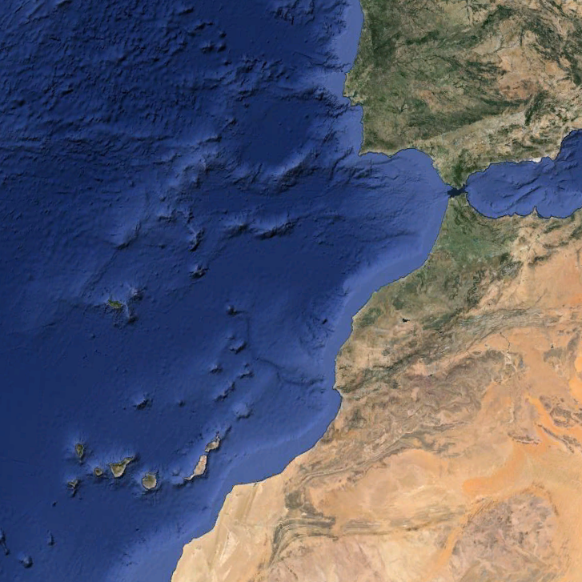
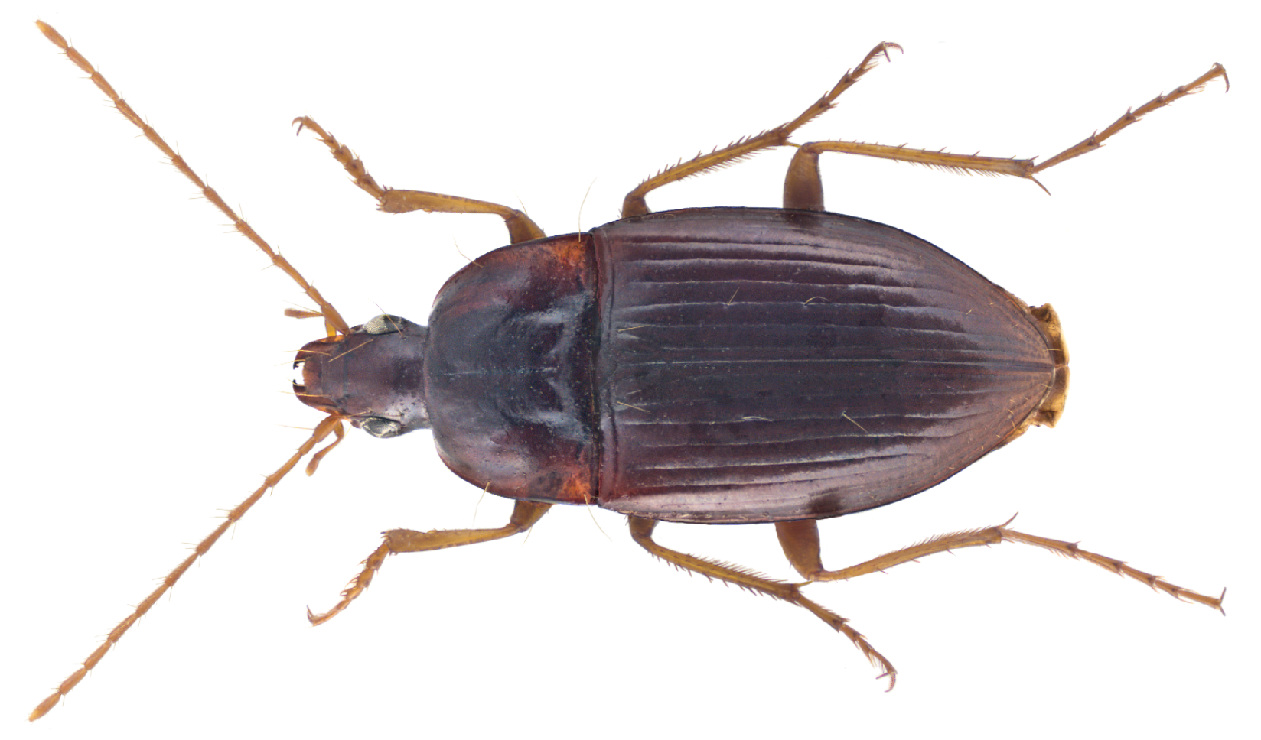
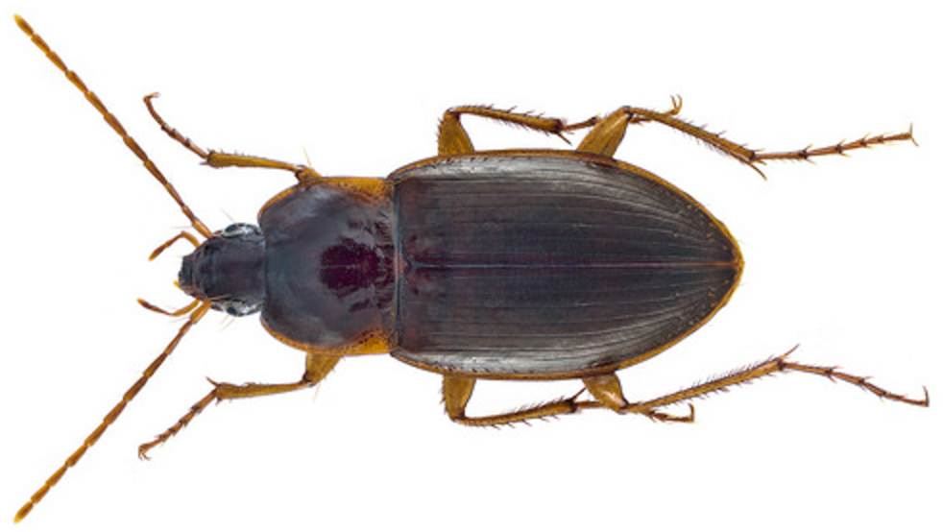
Species isolated as small populations change the most
Blackmon In prep
Notes:
Ok this is great this is a nice example of looking across a large phylogeny and seeing the same affect again and again lets dive in though and look at a much larger slice of one part of the tree

Slide 11
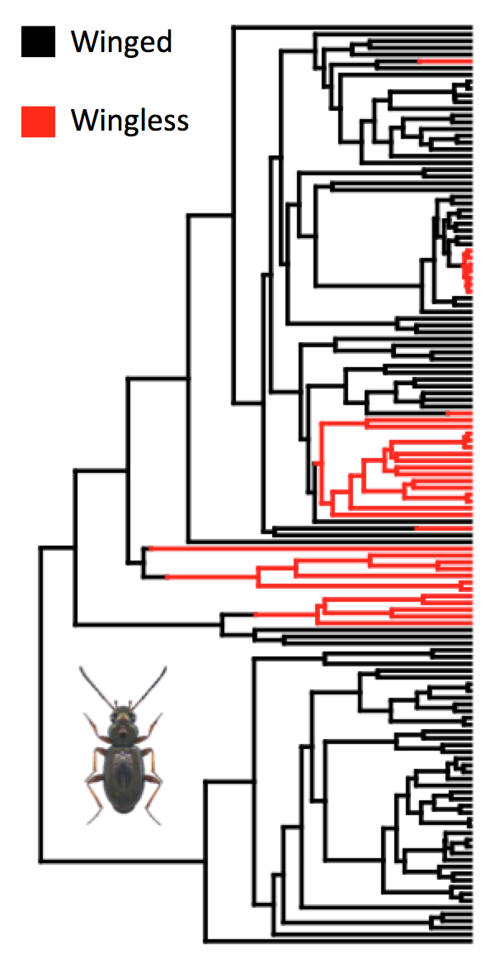
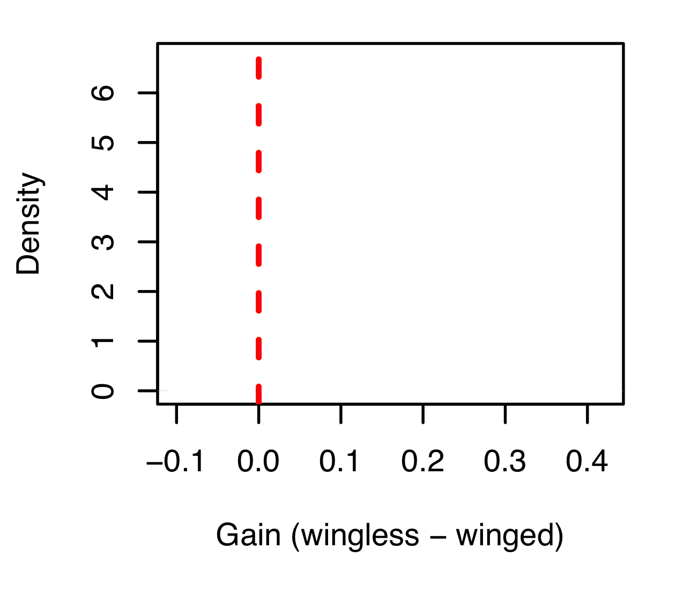
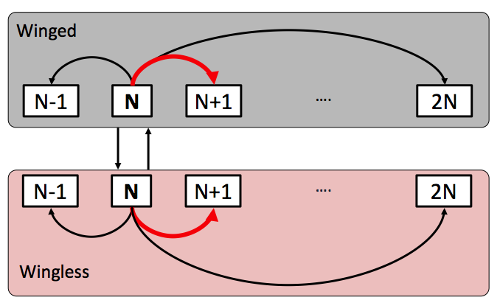
Wingless species have higher rates of evolution
Notes:
Label arrows so match next side

Slide 12
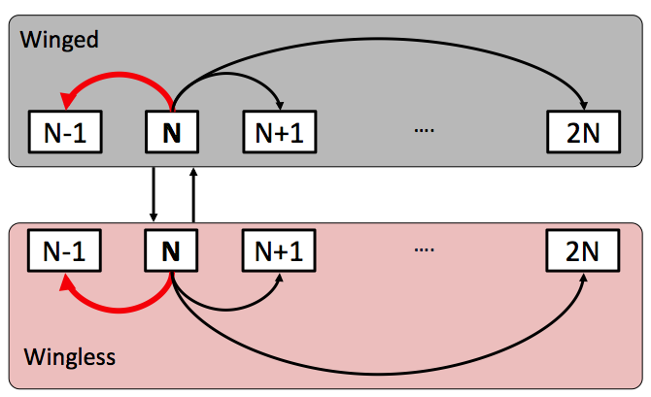
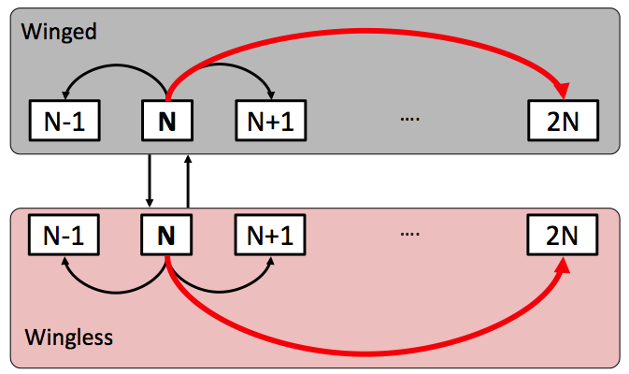
Wingless species have higher rates of evolution
Fission
Fusion
Polyploidy
Notes:
So we’ve now switched to a more biologically realistic model and we see this same pattern repeated

Slide 13
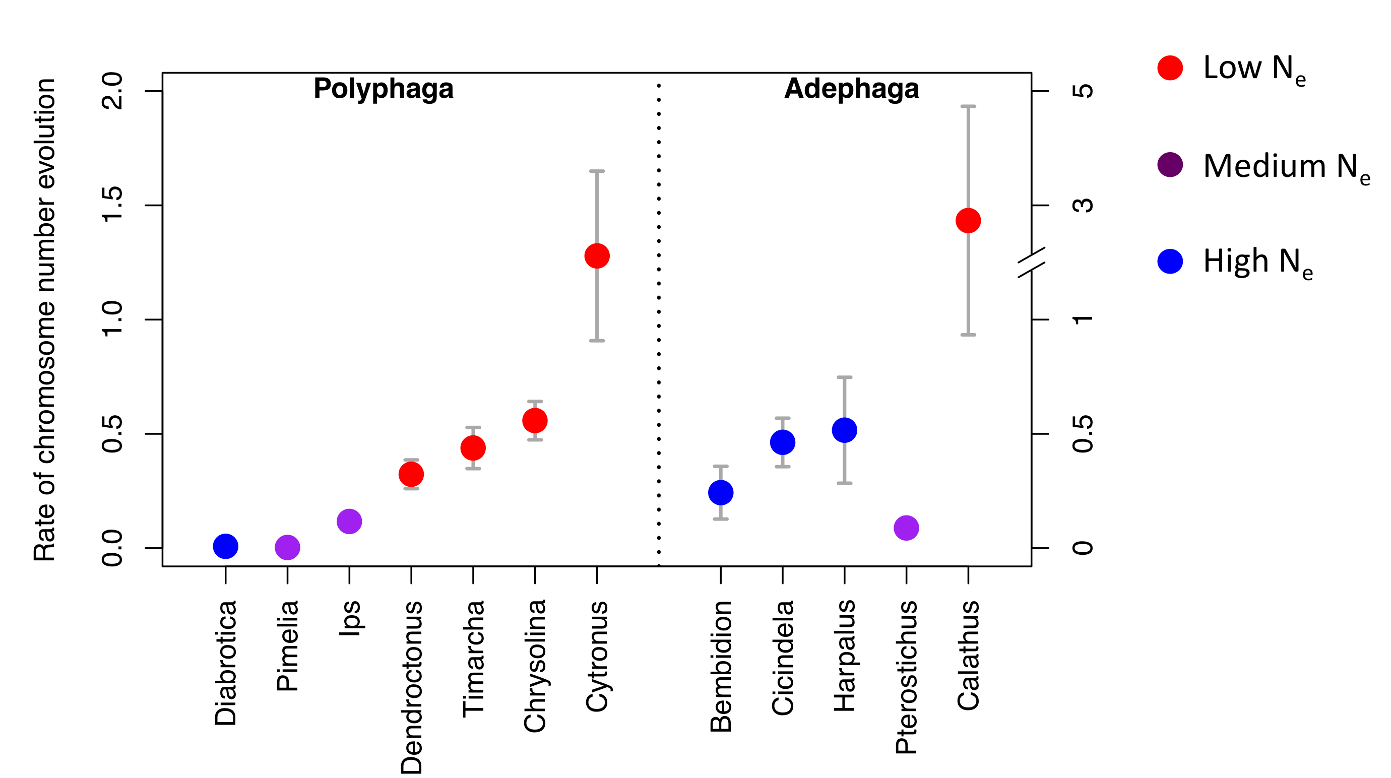
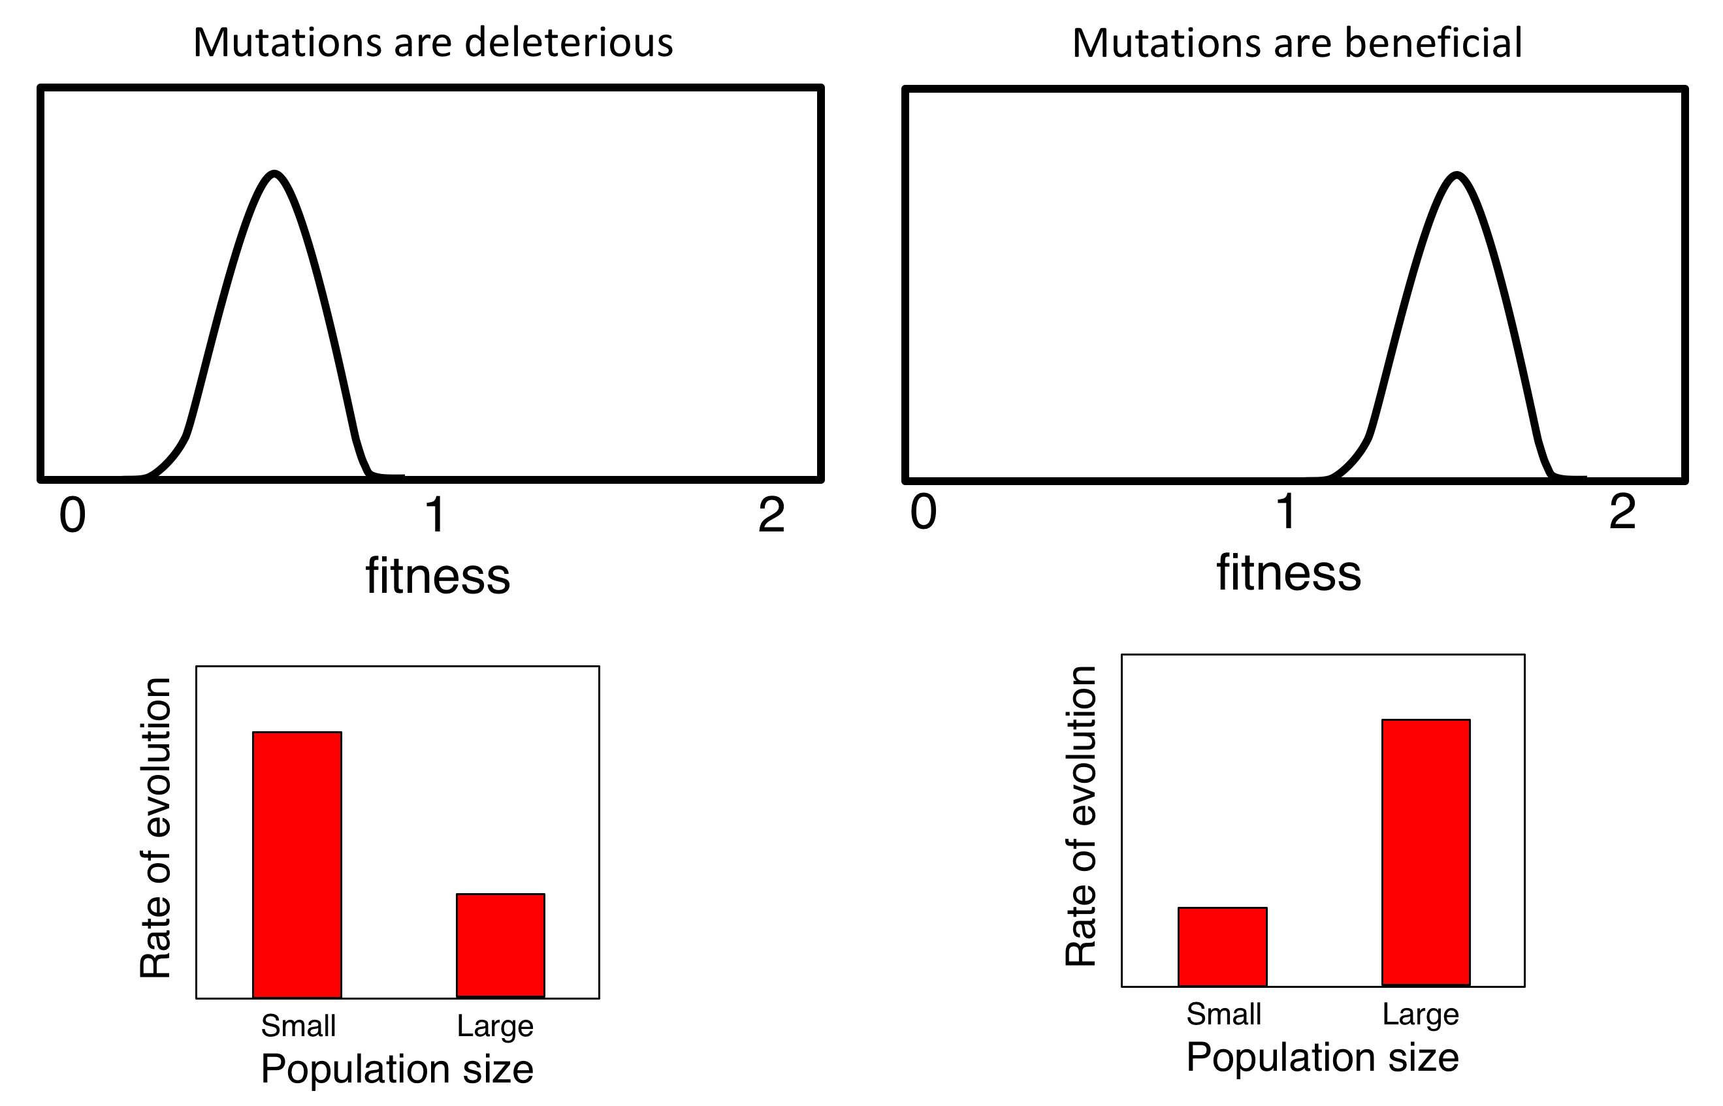
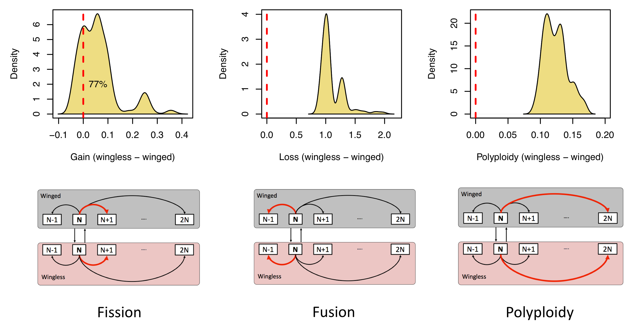
What is the fitness of mutations that change chromosome number?
Notes:
So lets take a moment to look at the patterns of chromosome number that we see across the tree of life.

Slide 14
Sexual antagonism is fundamental to our understanding of sex chromosomes
Recombining region
Male determining allele
Sexually antagonistic allele
inversion
Non-recombining region
inversion
What are these sexually antagonistic alleles?
PAR Pseudoautosomal Region
Autosomes
X Y
X Y
X Y
Notes:
What I want to do for a few minutes though is show you some other empirical observations that I think make it quite obvious what is missing from this canonical model.

Slide 22
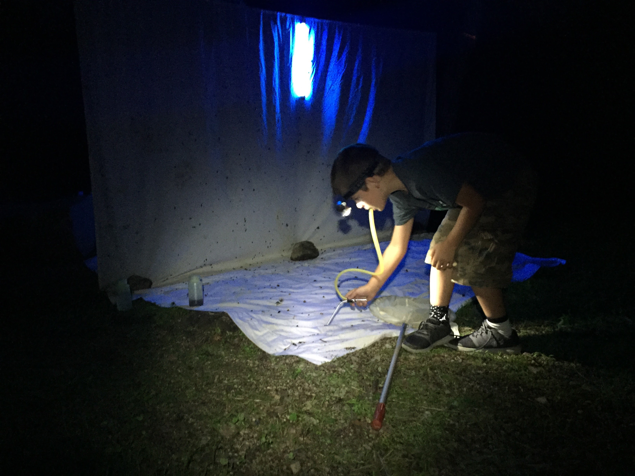
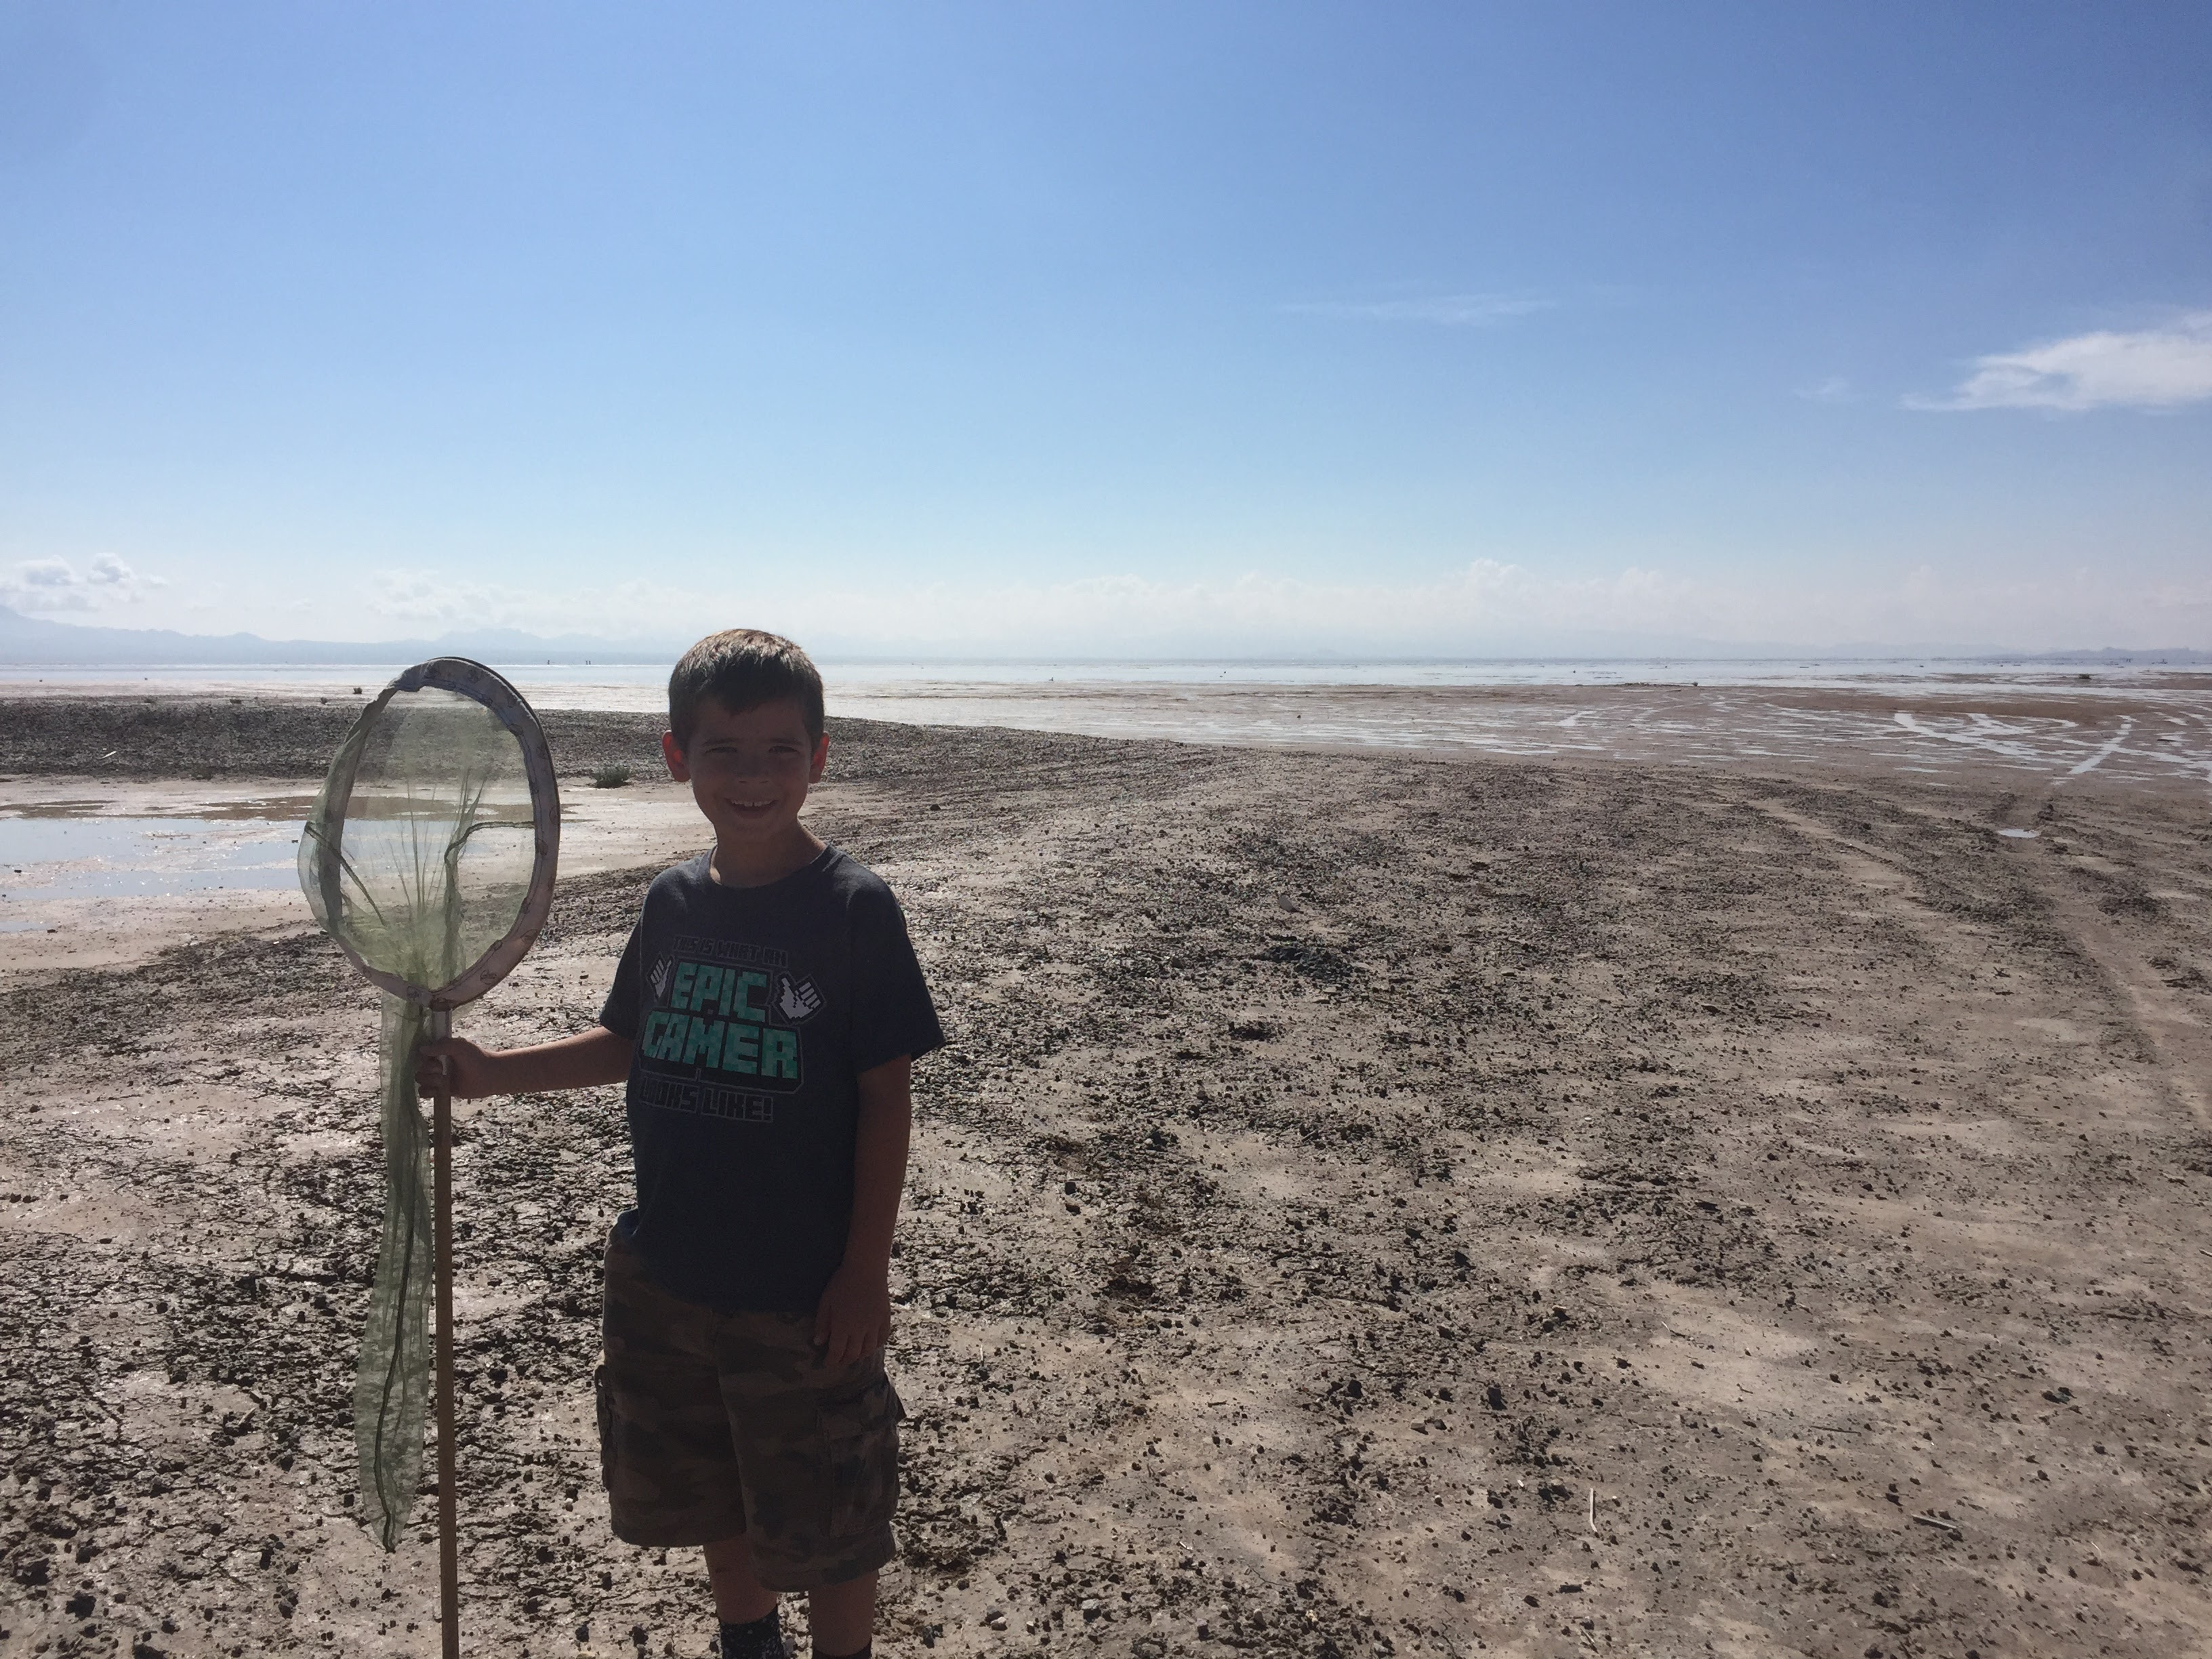
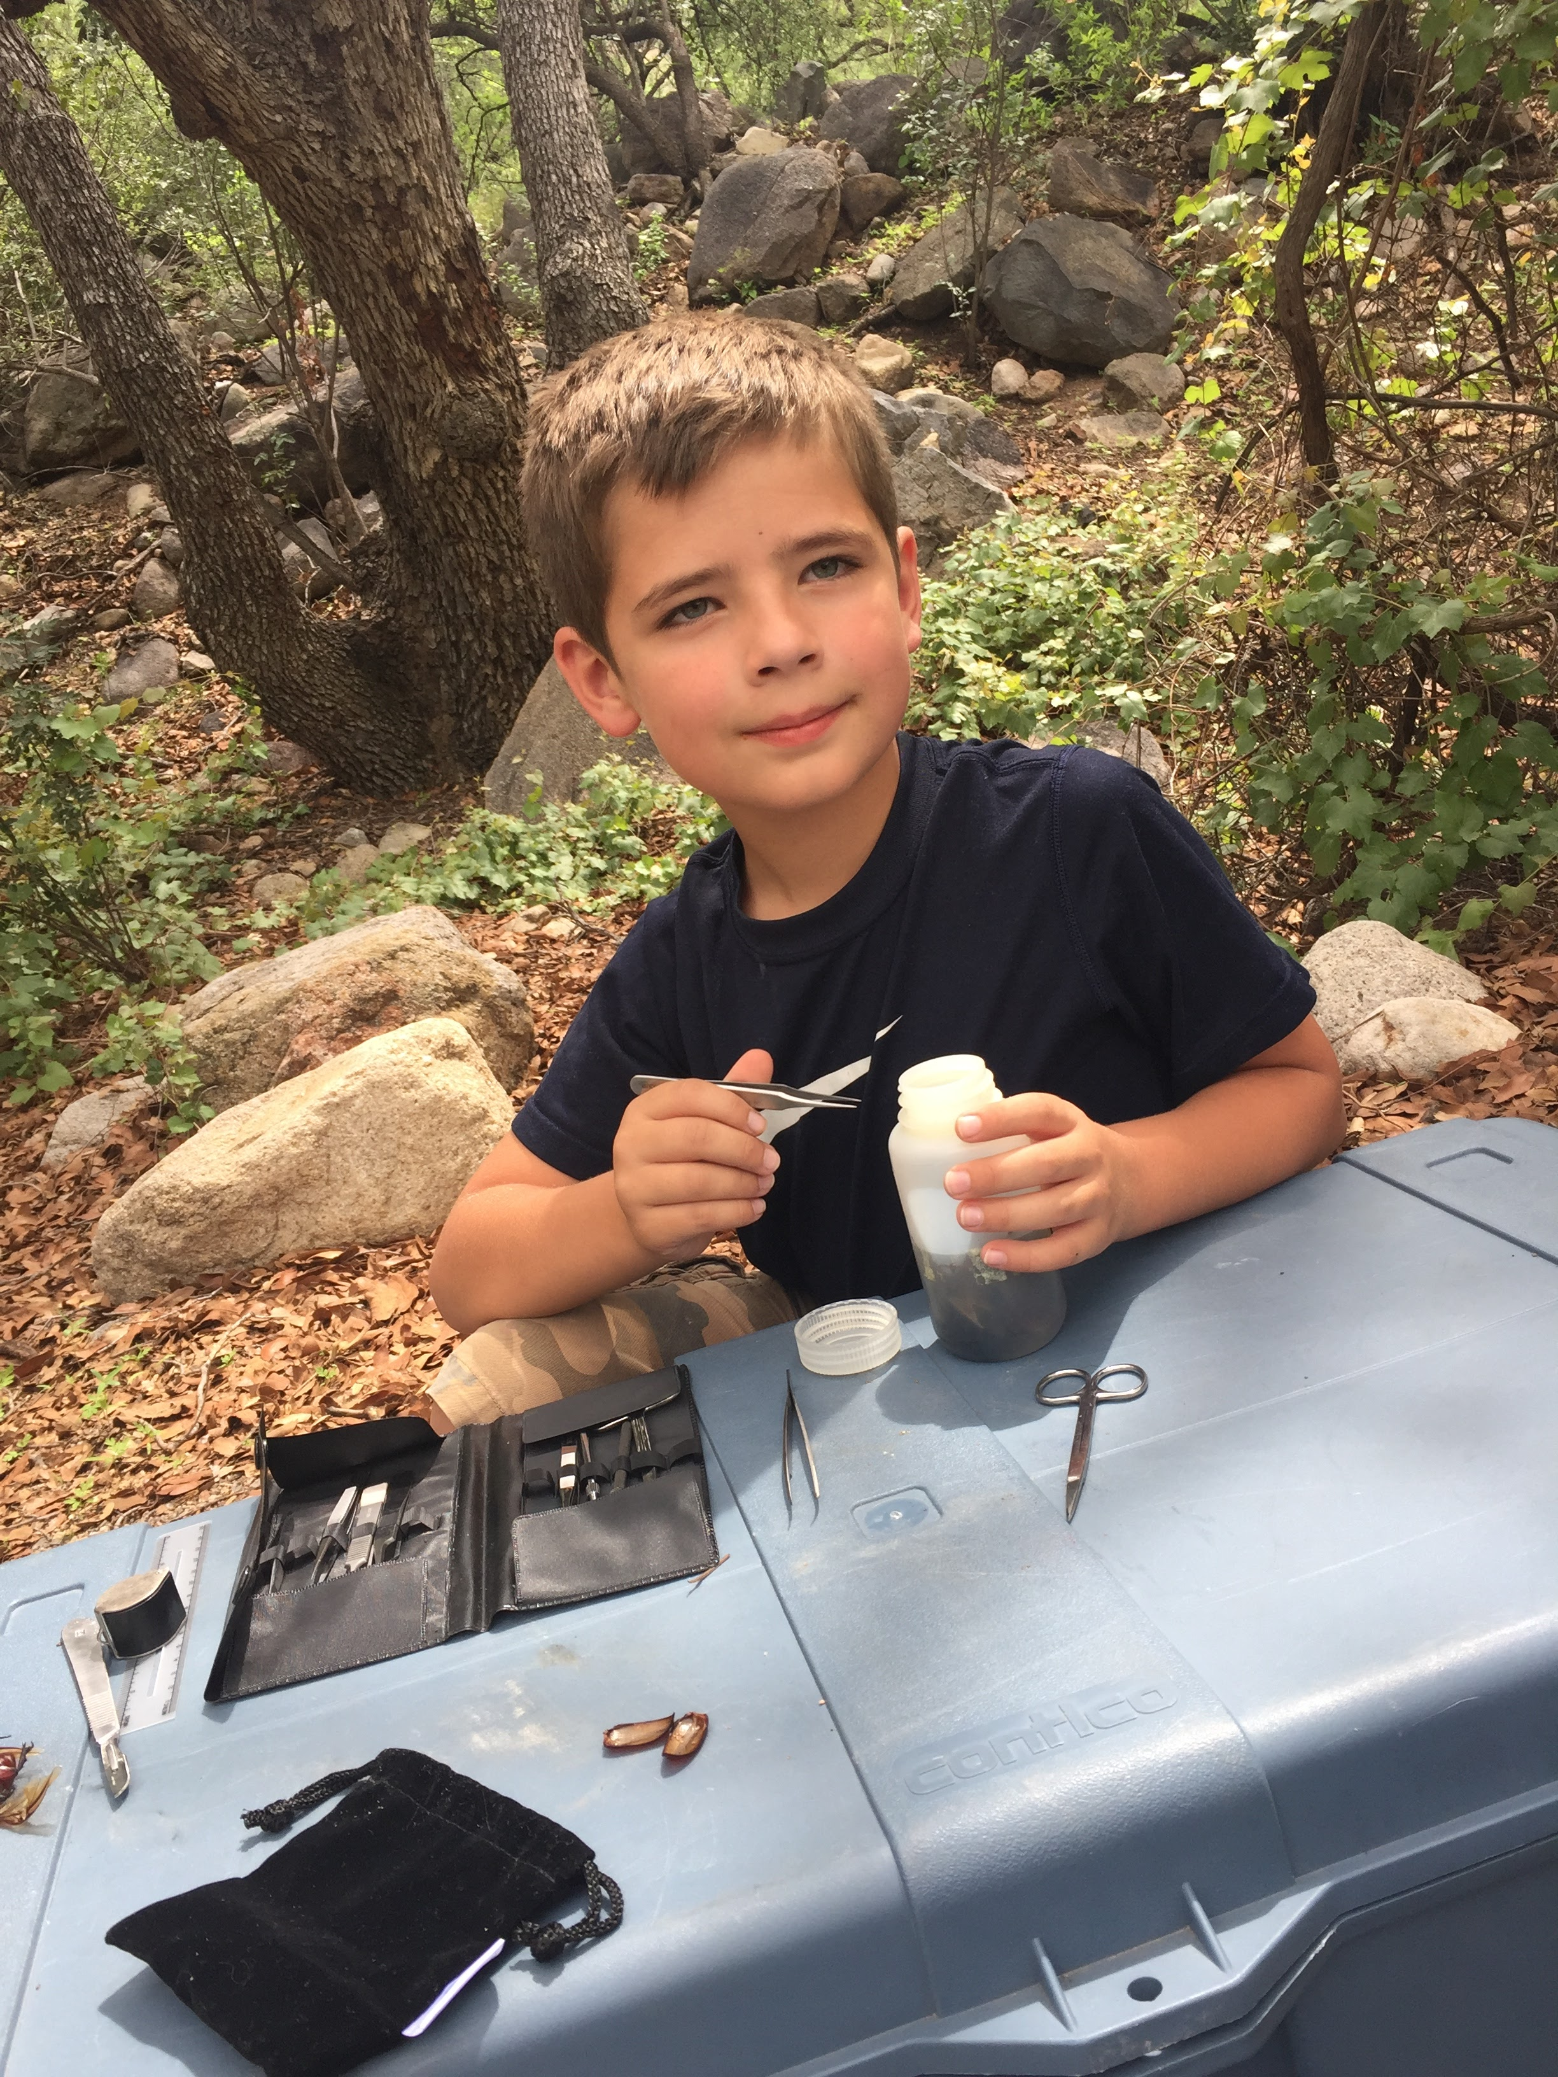
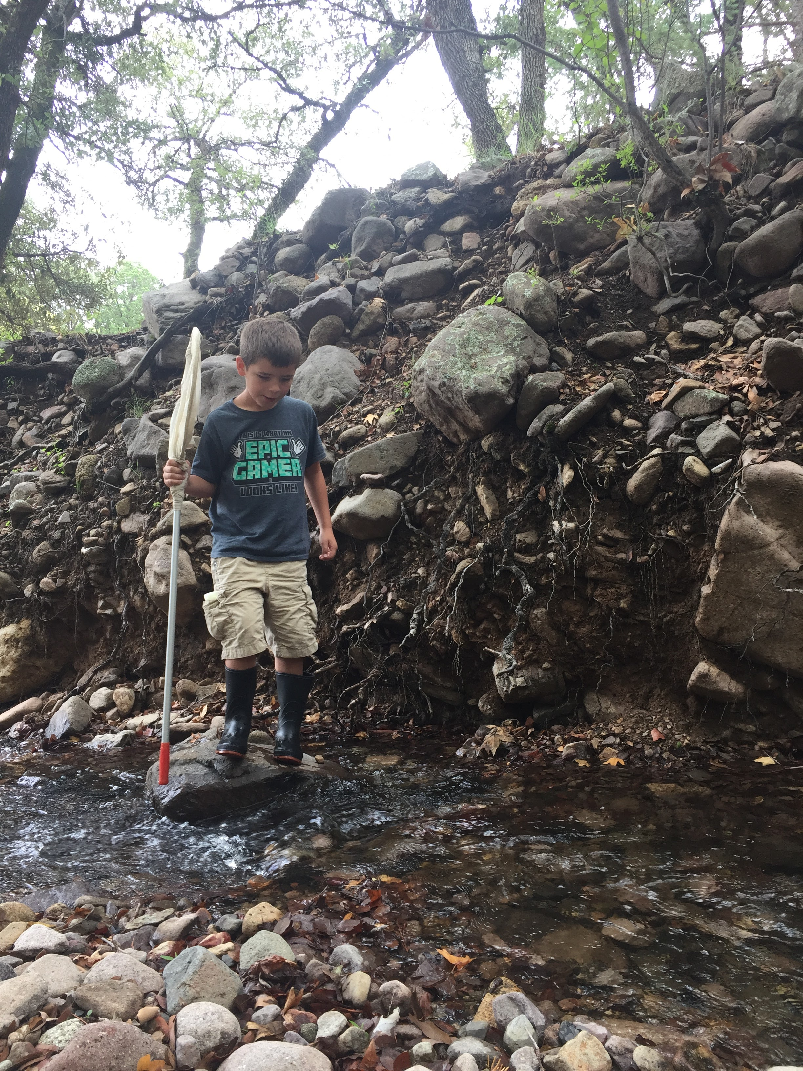
Thanks!

